Slide 1




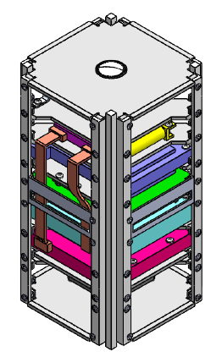


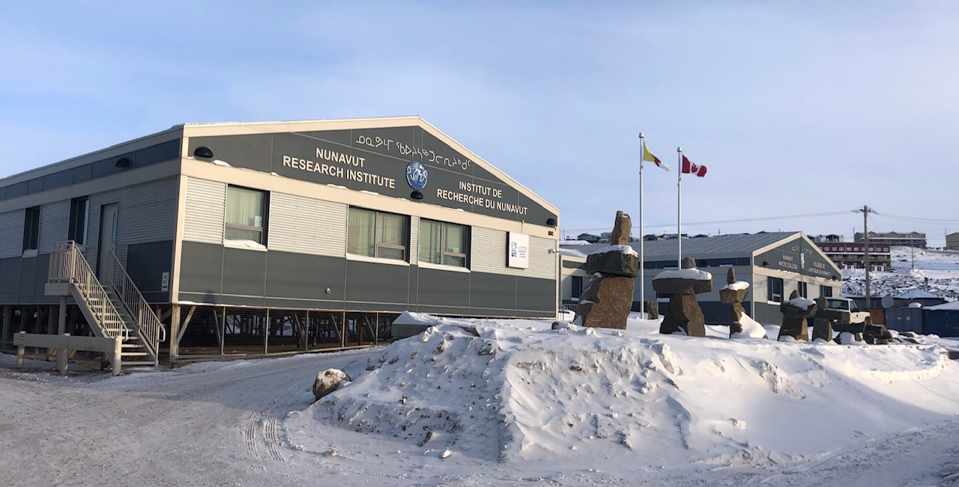




Western University – Nunavut Arctic College CubeSat Mission – Overview
J. Sabarinathan¹, M. Cross¹, M. Bourassa¹², K. Doerksen¹, N. Mitchell¹, A. Pascual¹, B. Southwell¹ and the Western University CubeSat Team.
¹ Dept. of Electrical and Computer Engineering, University of Western Ontario, London, ON.
² Dept. of Earth Sciences, University of Western Ontario, London, ON.
Email: jsabarin@uwo.ca – Facebook: @uwocubesat
CANADIAN CUBESAT PROJECT
The Canadian CubeSat project is 15 grants awarded by the Canadian Space Agency to post-secondary institutions across Canada. The objectives of this initiative are:
Increase student’s interest in STEM, particularly in space domains
Develop students’ expertise in space domains
Give students hands-on experience and prepare them to enter the job market
Advance space science and technology
WHAT IS A CUBESAT?
WHY USE CUBESATS?
A CubeSat is a miniature cube-shaped satellite. It’s dimensions are 10cm x 10cm x 10cm per one unit, and it can be stacked to a maximum of 24 total units. Its main structure is made of aluminum and holds all of the satellite’s components.
CubeSats have many advantages to them! They can be built rapidly – within 24 months, use simple technology that can be purchased off-the-shelf, are relatively simple to design, low cost, and don’t cause additional space debris – they burn up in the atmosphere upon re-entry.
WHAT CAN CUBESATS DO?
WHO USES CUBESATS?
CubeSats are usually designed for a combination of one of more of these types of missions: technology demonstration, scientific research, an educational project, or for commercial use.
Schools
Give students experience in developing flight hardware and conducting space missions
Assist professors and faculties in preparing Canada’s next-generation skilled workforce
Government & Industry
Provides a platform for low-cost technology demonstration and scientific research
Enables the acceleration of flight-qualified technology
Generated innovative public-private partnerships
Offers opportunities to develop the expertise and skills required for careers in the space sector
OUR MISSION
Provide an experiential learning and training opportunities for students in spacecraft development and operations, and in STEM outreach program development and delivery
Integrate and operate the Canadensys Nano VR camera in orbit for space and education
WESTERN UNIVERSITY – NUNAVUT ARCTIC COLLEGE COLLABORATION
The University of Western Ontario has partnered with Nunavut Arctic College on the development of the CubeSat. This includes Arctic College's contribution to the project by providing a component to be flown on the CubeSat, naming the satellite, and Western University providing educational outreach and training opportunities to the Nunavut community.
We gratefully acknowledge funding and support from
Notes:
https://www.shutterstock.com/video/clip-13416665-earth-orbiting-satellite-beautiful-sunrise-over-north
-need to acknowledge CSA, canadesnsys, AGI/STK
-show cubesat with one face hidden to see inside to point to subsystems
-would like the earth image to be faded/transparent a bit

